Slide 1


Slide 2

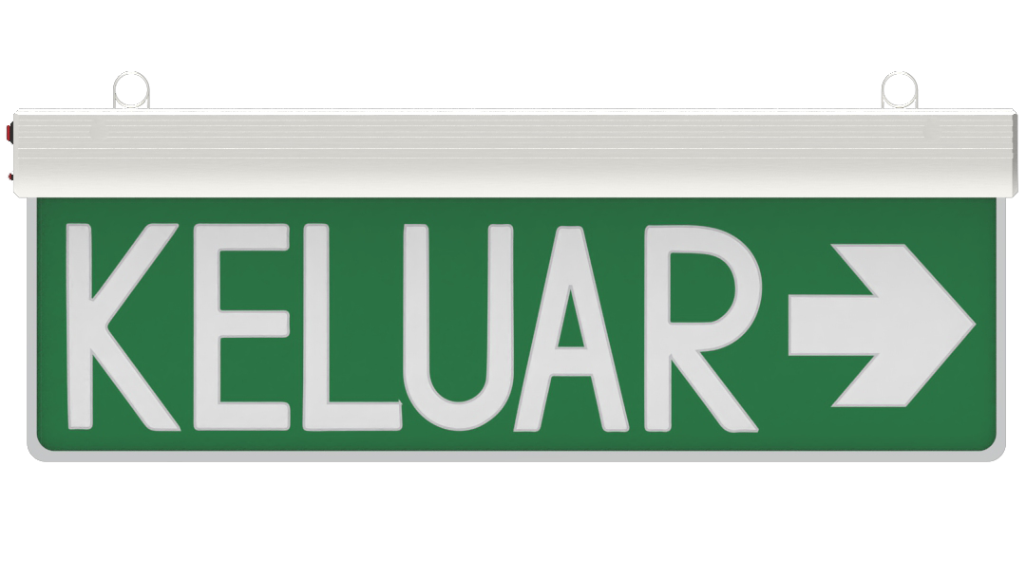
Container Escapes for Dummies
A gentle introduction to Docker container escapes

Slide 3
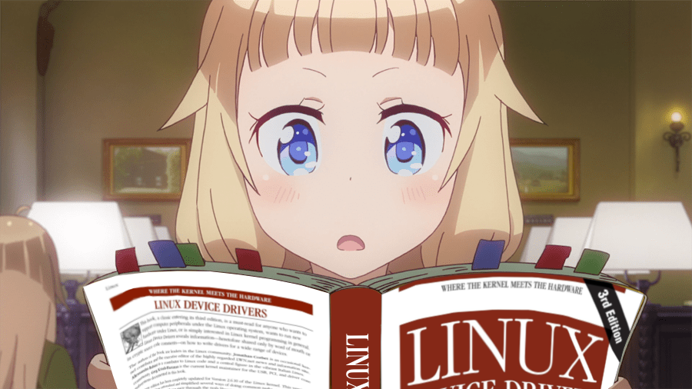
“container is just like using a VM”
sakura nene (2026)

Slide 4
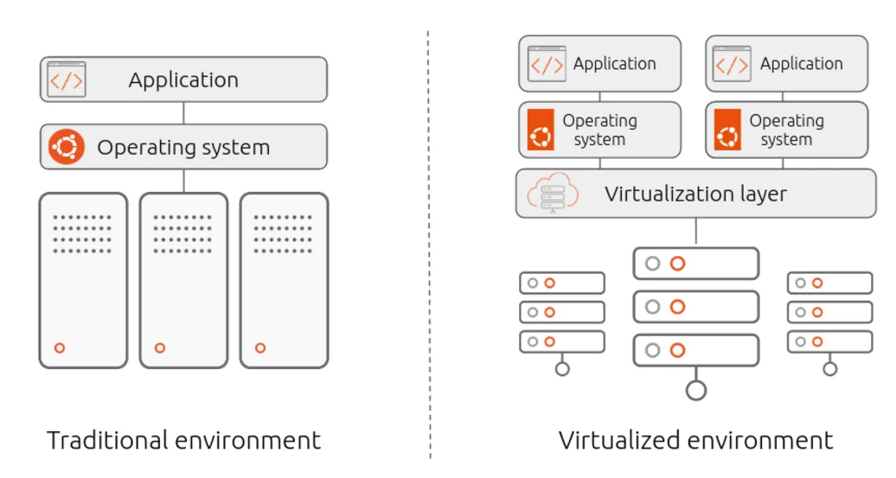
VMs and Containers
Runs on top of a hypervisor
VM image that includes the filesystem and state of the machine’s memory
The hypervisor “emulates” hardware for the VM

Slide 5
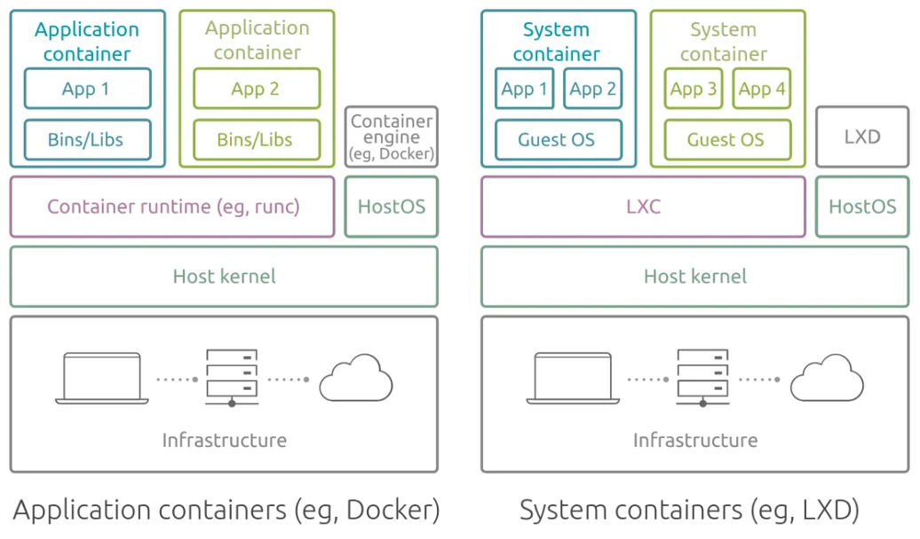
VMs and Containers
Runs on a shared kernel
A container is like a process
Each process is “isolated” through Linux namespaces
Makes it appear like a separate Linux machine
Notes:
Because containers do not have their own isolated kernel, any vulnerability within the shared host kernel or misconfiguration in these logical boundaries can allow a process to break out of its namespace and interact directly with the host system.

Slide 6

Container escapes
There is vulnerability in the container runtime or in the kernel that allows you to break namespace isolation.
Misconfigured containers.

Slide 7
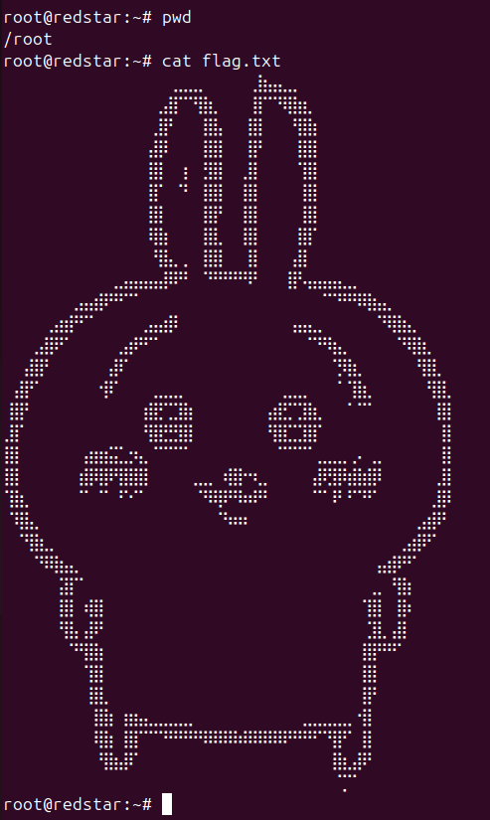
Demos
For all the examples, the goal is to read flag.txt in my host’s /root directory.

Slide 8

Example 1: Privileged containers
God mode
Containers start with a restricted set of capabilities (safe defaults)
Privileged -> we are root on host :D

Slide 9
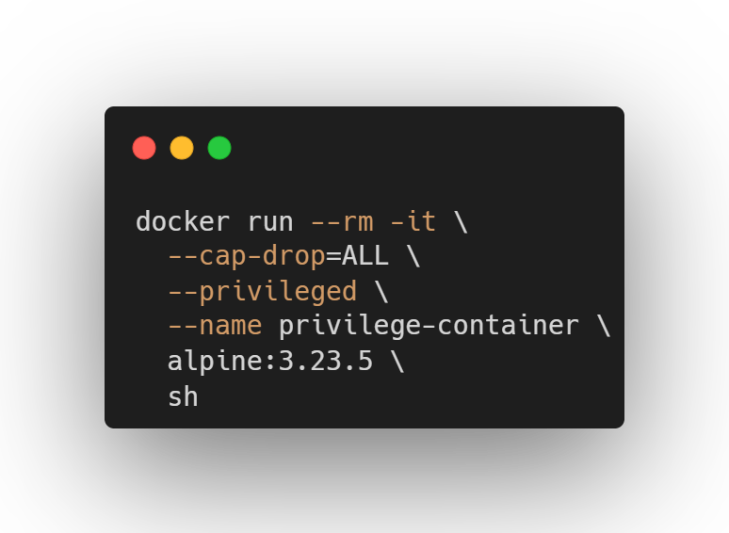

Slide 10
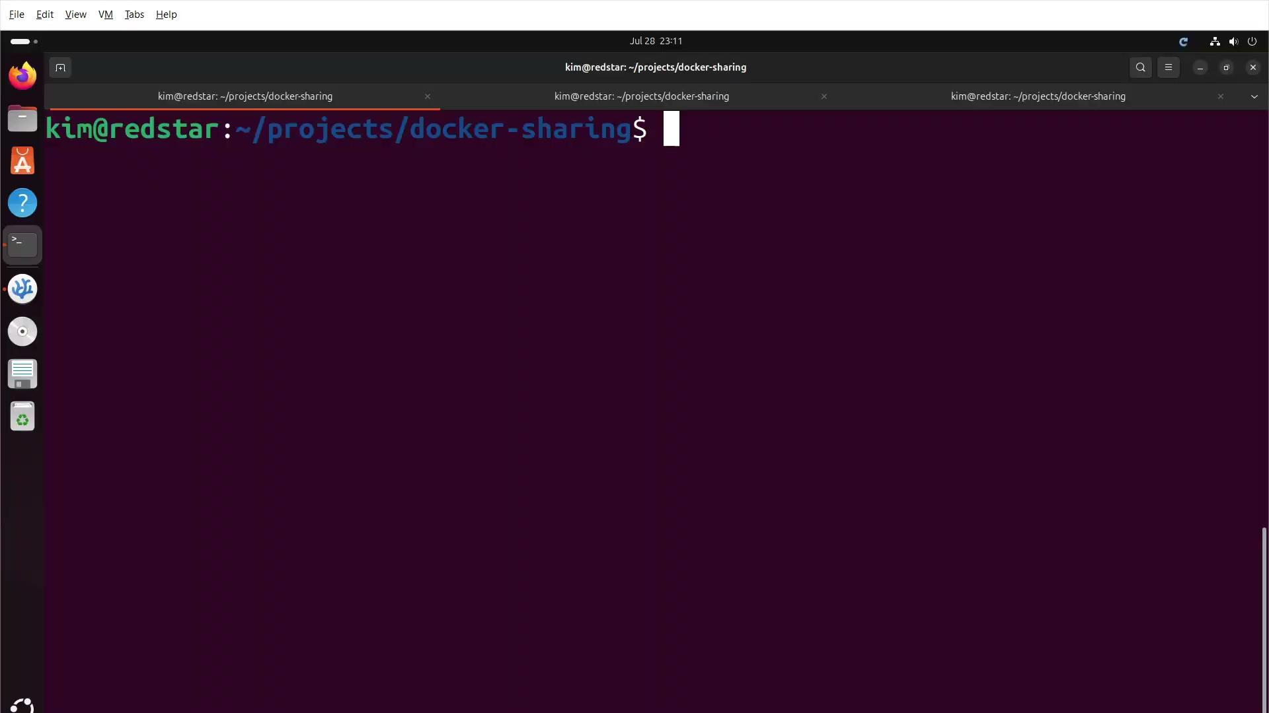

Slide 11

Example 2: Excessive capabilities
Capabilities define what a process can do
Gives you granular control over permissions instead of just granting root or having too much restrictions
40 capabilities in the kernel
CAP_SYS_CHROOT, CAP_SYS_ADMIN, CAP_SYS_PTRACE, CAP_SYS_MODULE, blah blah blah…

Slide 12
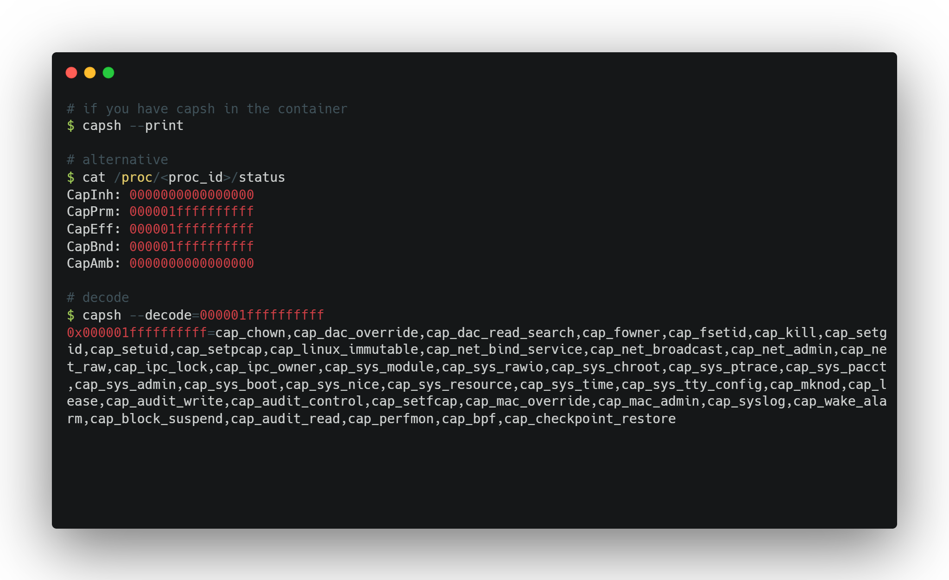
Notes:
CapEff - effective capabilities at runtime
CapAmb - ambient capabilities that persist across unprivileged runs of the program

Slide 13
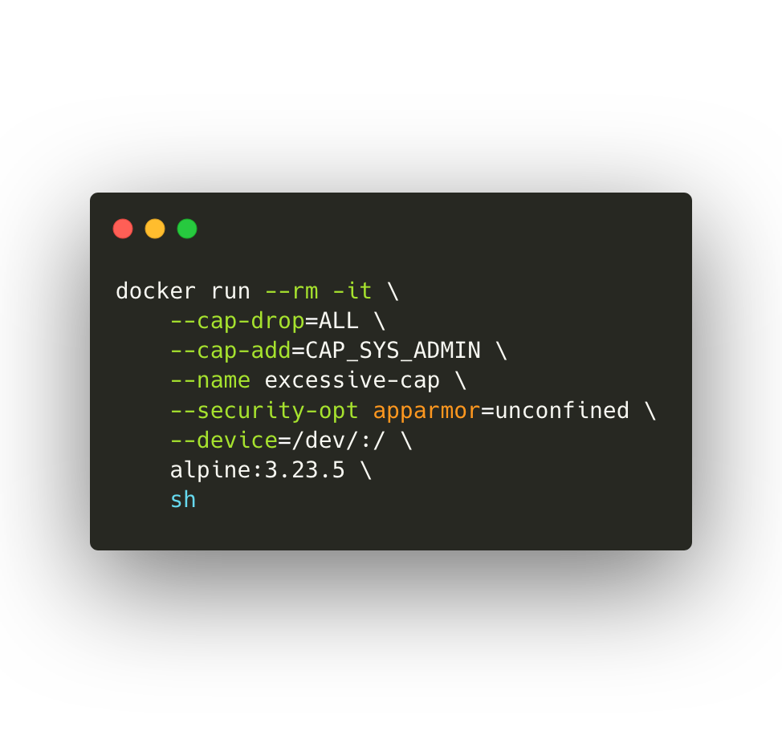

Slide 14
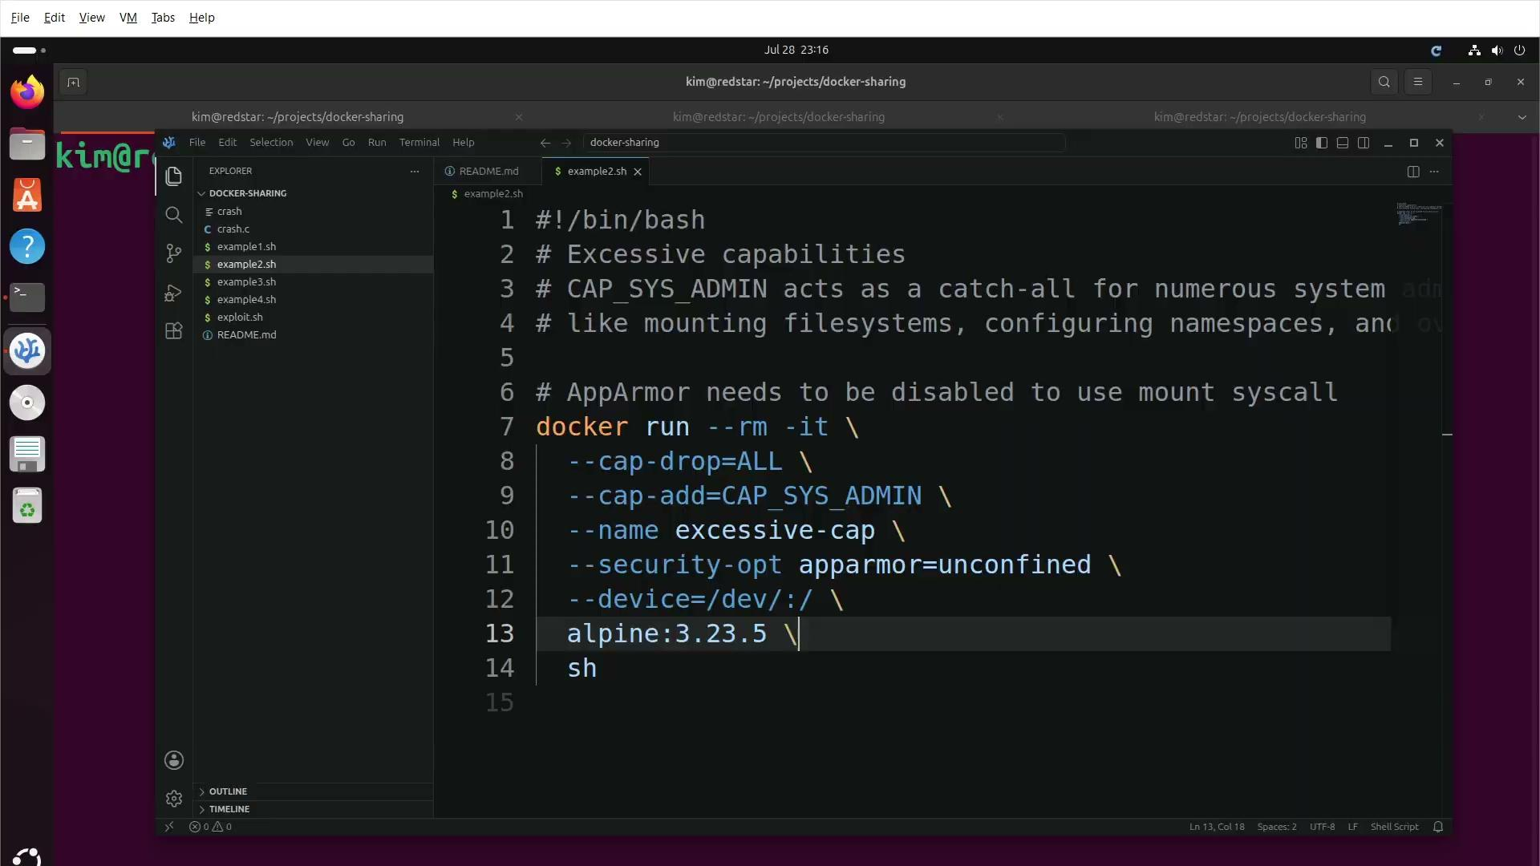

Slide 15

Example 3: Sensitive host mounts
Sharing the host file system with your container
The -v flag
Escape/privesc depending on what you mount
If the mount is sensitive/high privileged, the container is granted read and write access to it

Slide 16
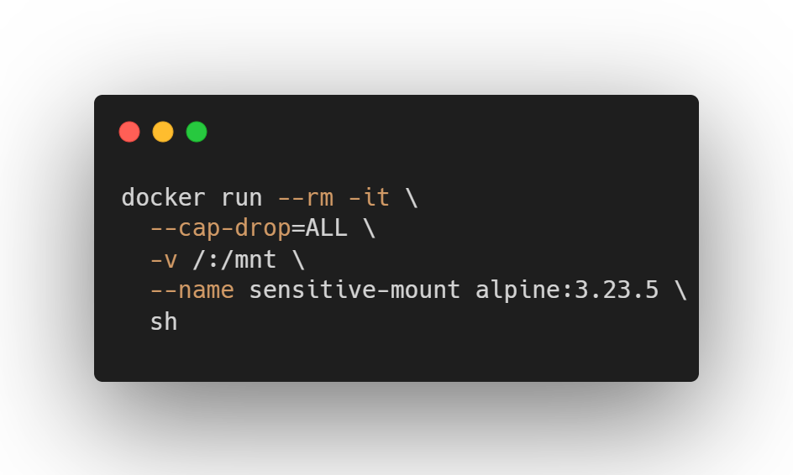

Slide 17
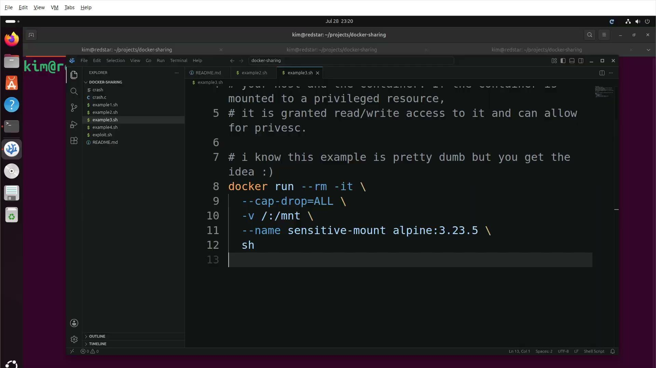

Slide 18

Example 4: Exposed docker socket
Mounting docker socket inside of another container
Containers inside of a container (???)
Allows you to talk to the docker daemon directly
It’s unauthenticated 😳

Slide 19
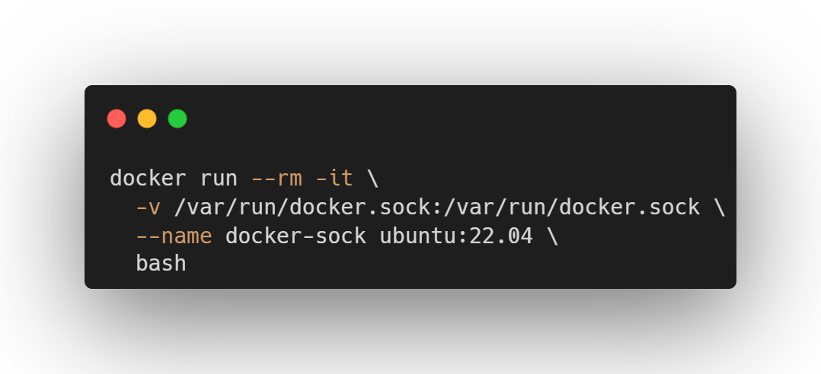

Slide 20
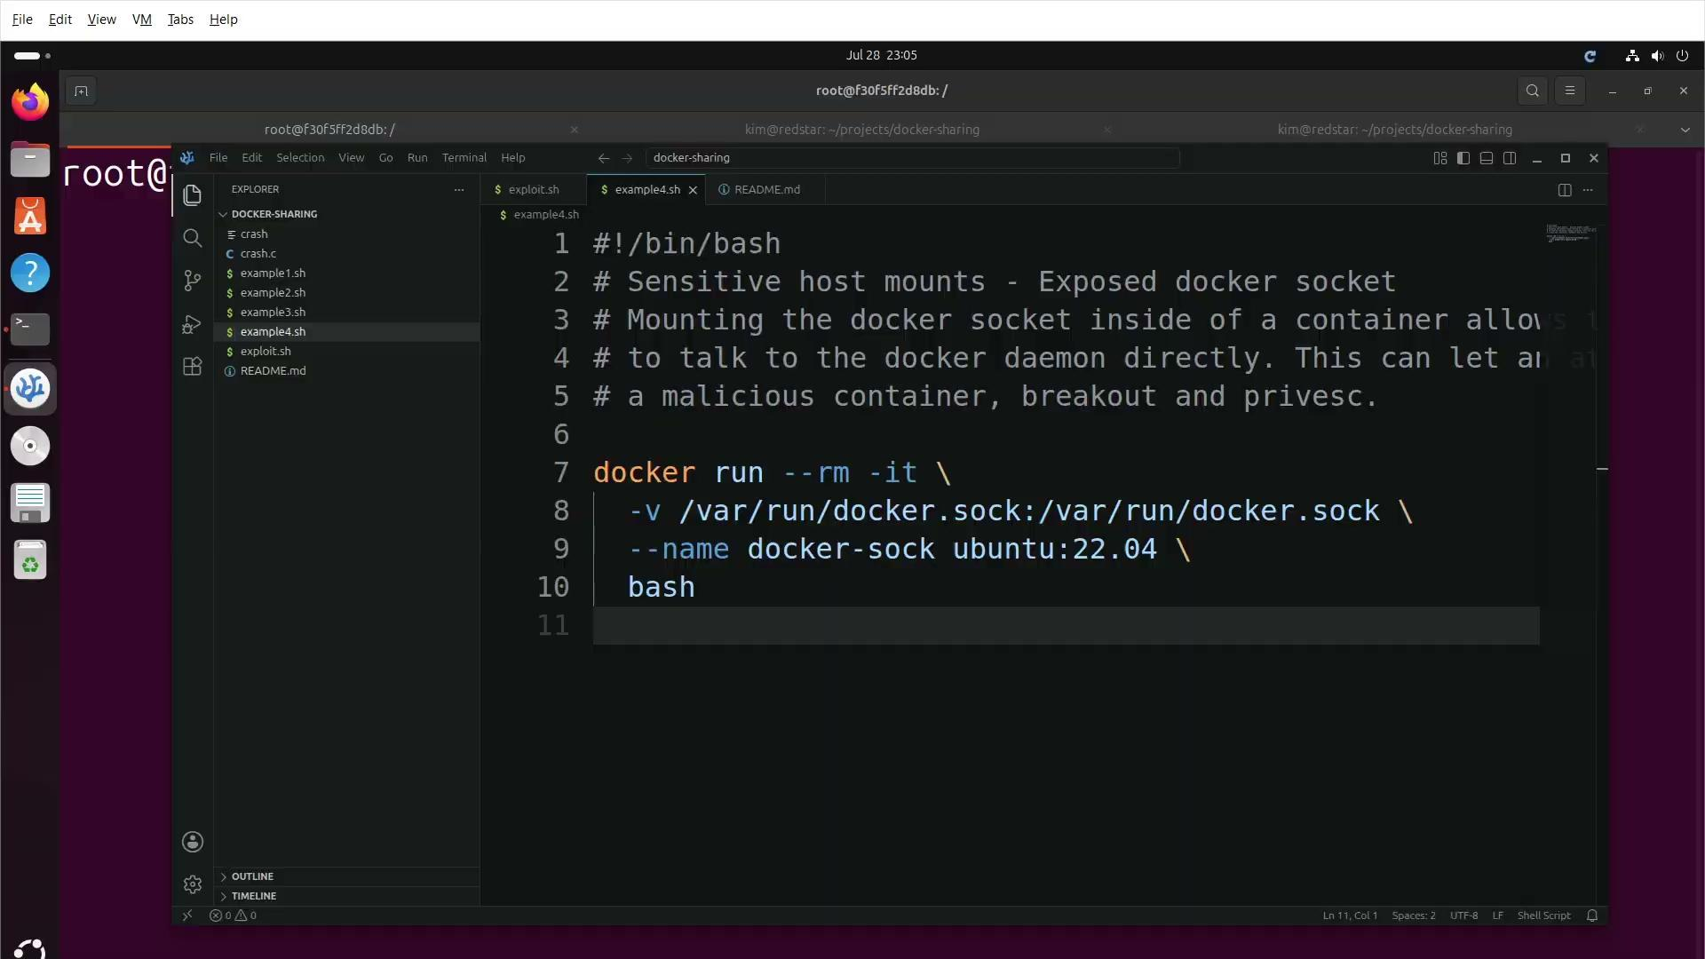

Slide 21

The end, goodnight

